Slide 1

2
0
2
1
Software Project and Process Management
Course Project Presentation
——Online Snack Store
Team Member
1853543 黄弋鸥
1852345 毛靖鑫
1853898 谭忠煜
1851350 陈扬森
Notes:
大侠素材铺 淘宝店：https://dxpu.taobao.com/

Slide 2
CONTENT
Monitor and Control
Business Case
05
03
Risk Management
01
04
02
06
Project Charter
Stakeholders
WBS
Activity Network
Resource Allocation
Project Implement
Prototype

Slide 3
2
Part 02
Project Charter

Slide 4
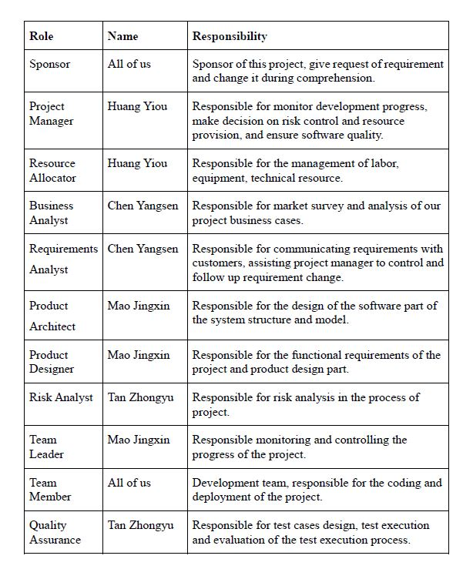
2
Stakeholders
Requirement provide and change
This part mainly shows the organization of our group members, their character in our project and the way of communication, that’s how to compose these people together.
We figure out our roles in the project.
Plan the activities and manage the team
Management related activities have their responsible persons
Manage the development team
The development team

Slide 5
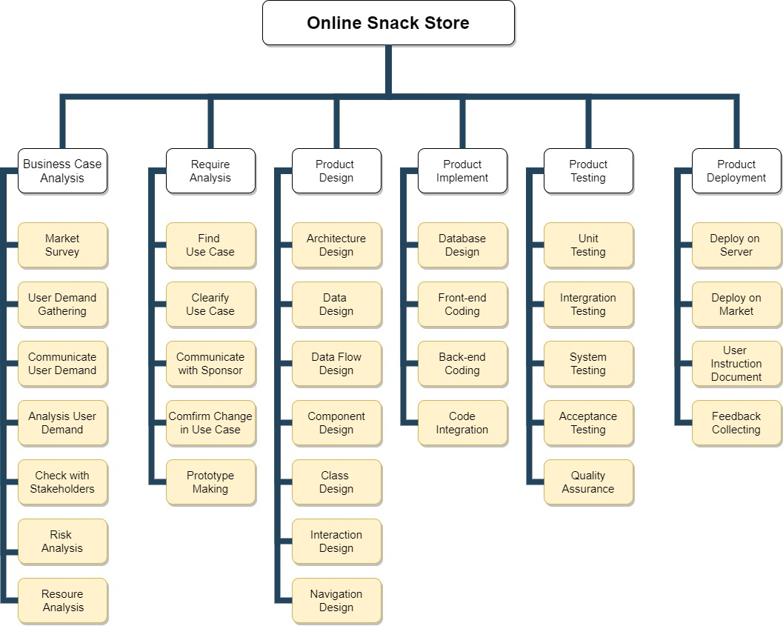
2
Work Breakdown Structure (WBS)
This part we will divide our project into several main parts and figure out the key activities in it.
The activities will be detailed in the next part.
We will figure out key activities and give a plan to conduct them.

Slide 6
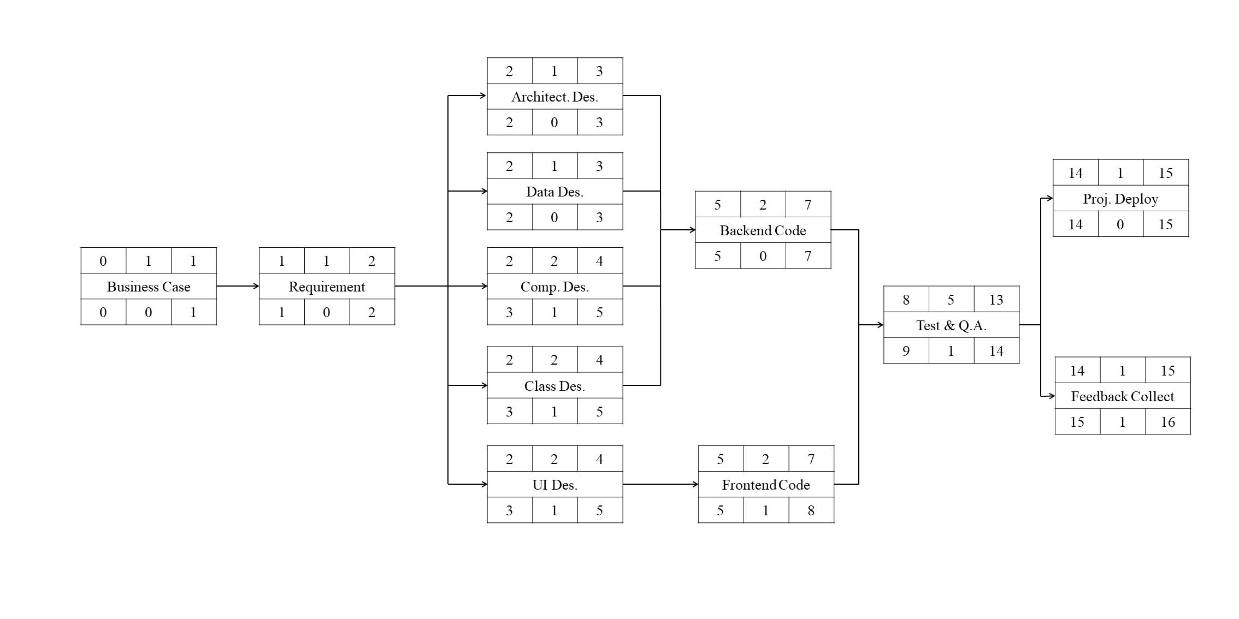
2
Critical Path Graph
Our project will start at March 5th, and end at June 30th according to plan. It will take about 16 weeks.
Critical path is marked by triangle sign.

Slide 7
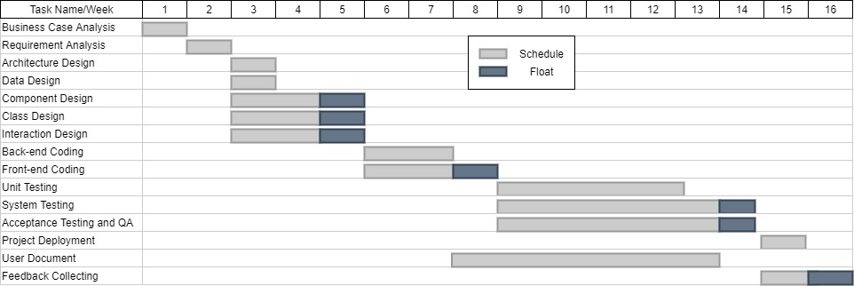
2
Relevant Gantt Chart
Relevant Gantt Chart shows more detailed information in the basis of CPG.
It leaves float slack time to give some space for adjustment.

Slide 8
3
Part 03
Risk Management

Slide 9
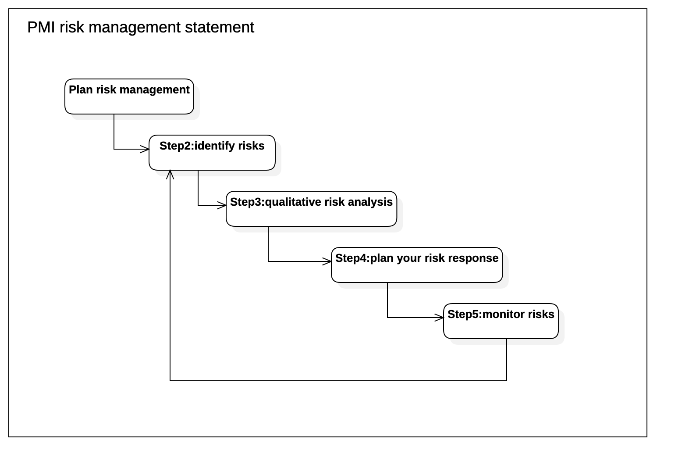
3
Risk Management Plan
Our team first formulated a risk management plan, based on the risk management steps of Project Management Institute(PMI) risk management.

Slide 10
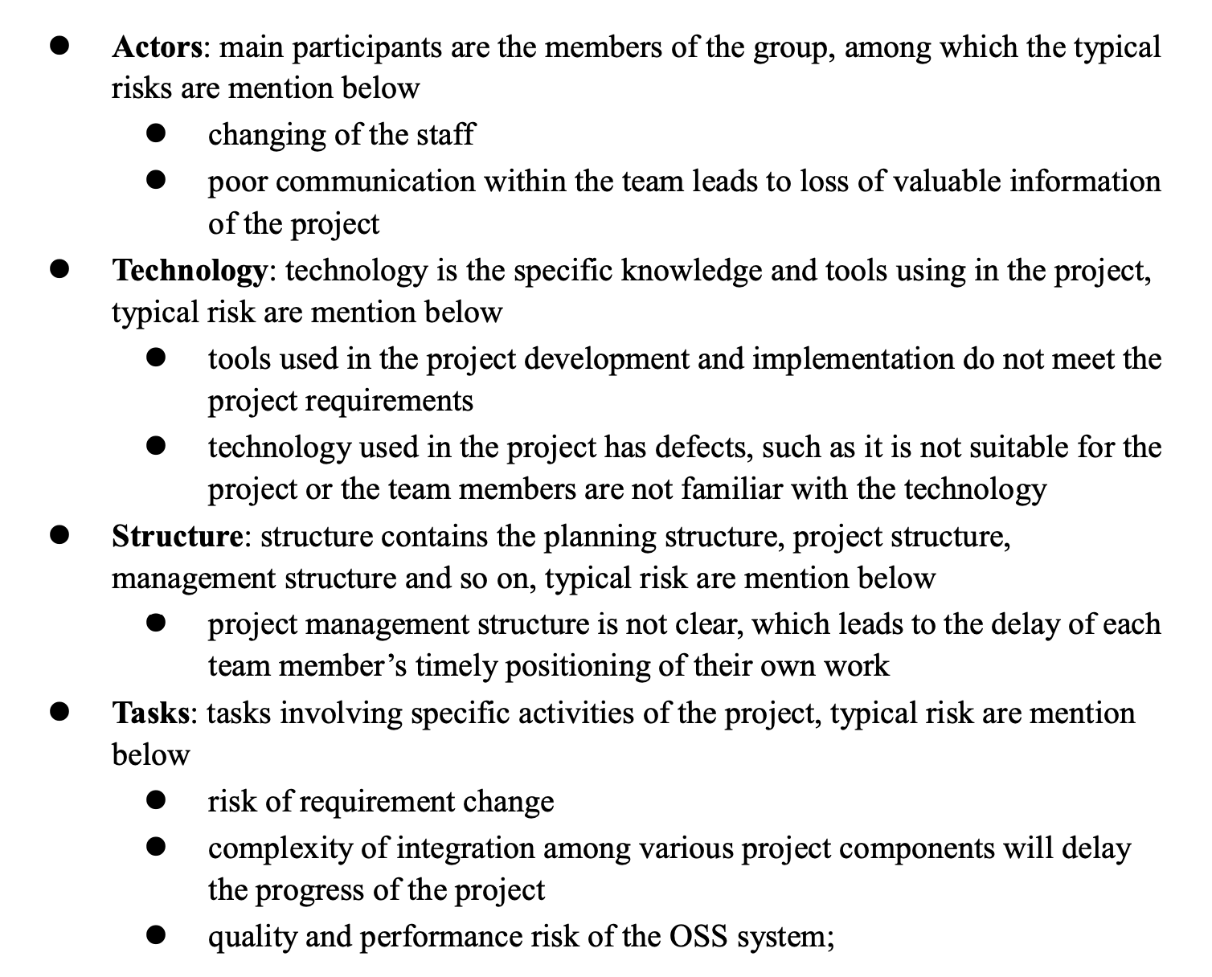
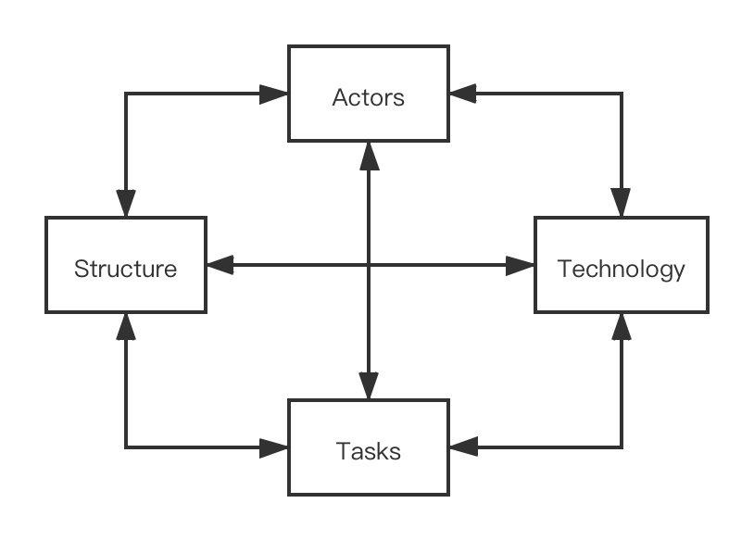
3
Categories of Risk
Then, in this part, we reference to “Lyytinen-Mathiassen-Ropponen” risk framework and we divided the risk factors into four parts.

Slide 11
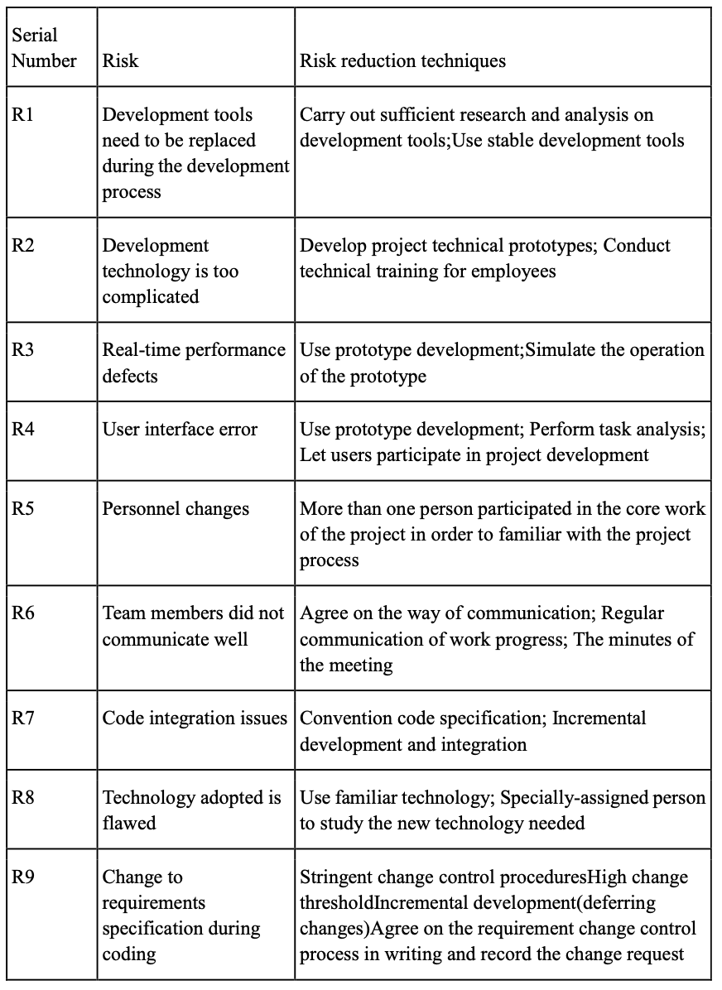
3
Risk Identification
In the risk identification of this project, we adopted the risk identification method combining Checklist method and Brainstorming method, referred to checklists models such as lyytinen model and Barry Boehm model, and established our own checklists as follows.

Slide 12
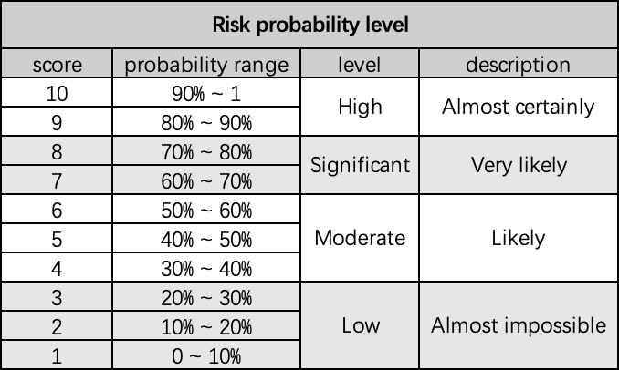
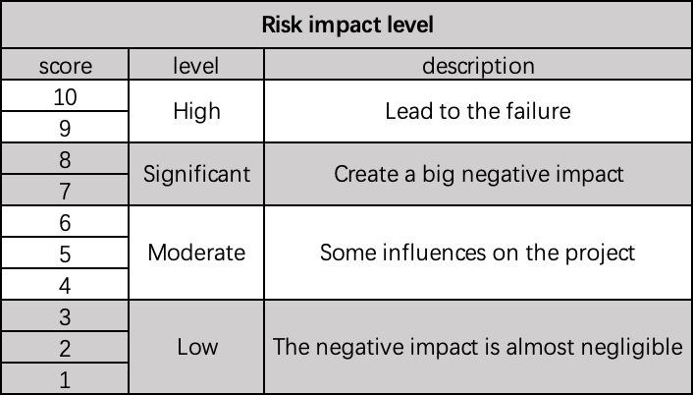
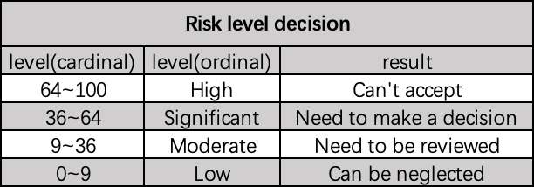
3
Risk Analysis, Assessment and Prioritization
Then we define the risk probability using score from 1 to 10, and we divide them into 4 levels from extra-high to extra-low.

Slide 13
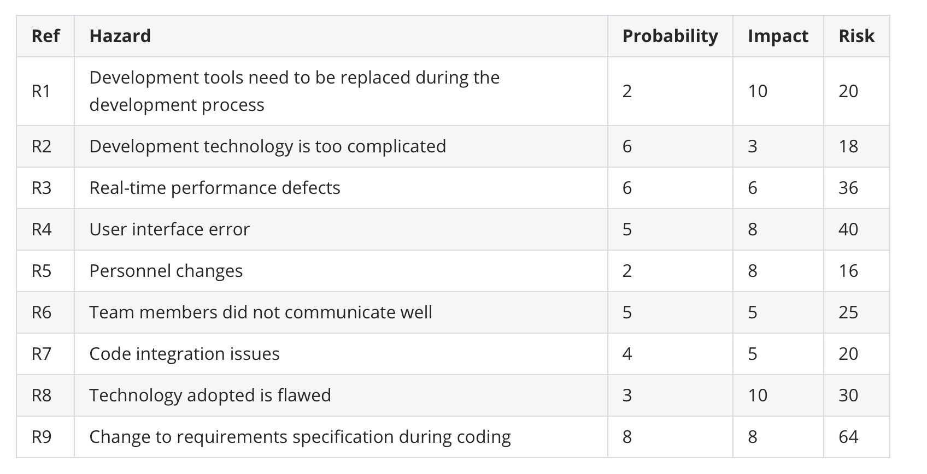
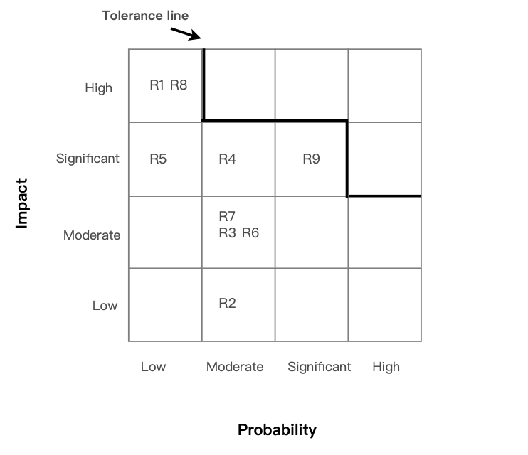
3
Risk Analysis, Assessment and Prioritization
After defining the levels, we analyzed the potential risks . Then we simulate the risk exposure during our brainstorming, and we use Barry Boehm's method for risk exposure assessment. The probability impact matrix is as follow.

Slide 14
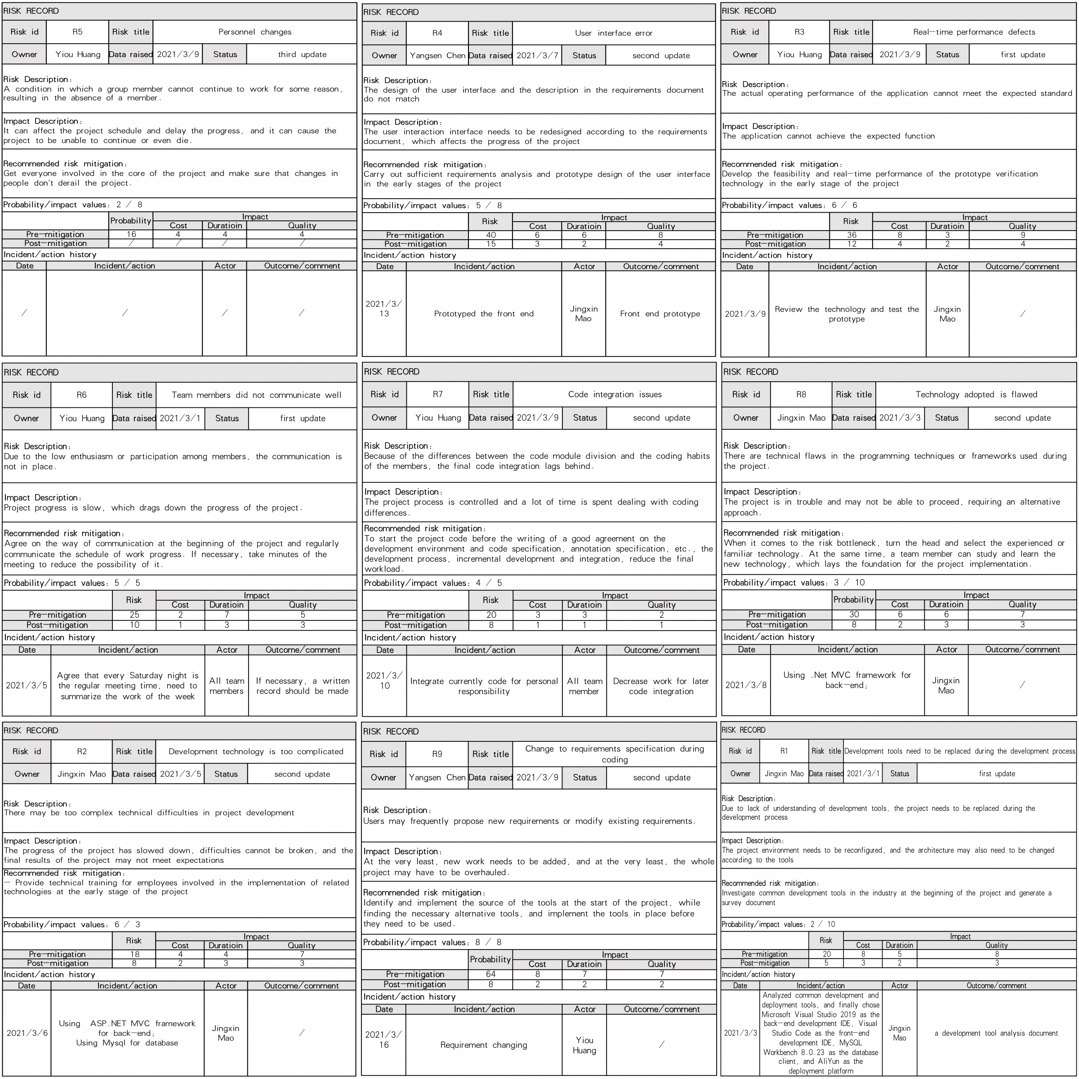
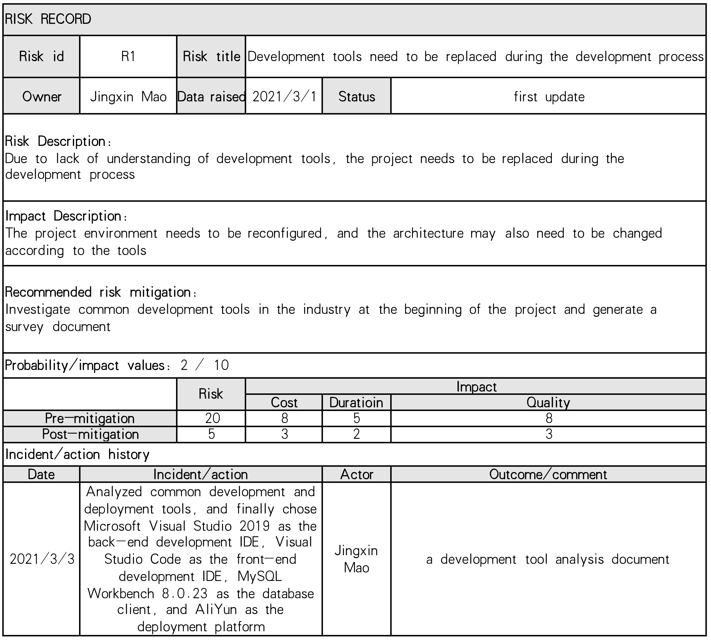
3
Risk Register.
We picked out and examined what appear to be the most threatening risks to the project, creating and maintaining our findings in a Risk Register.

Slide 15
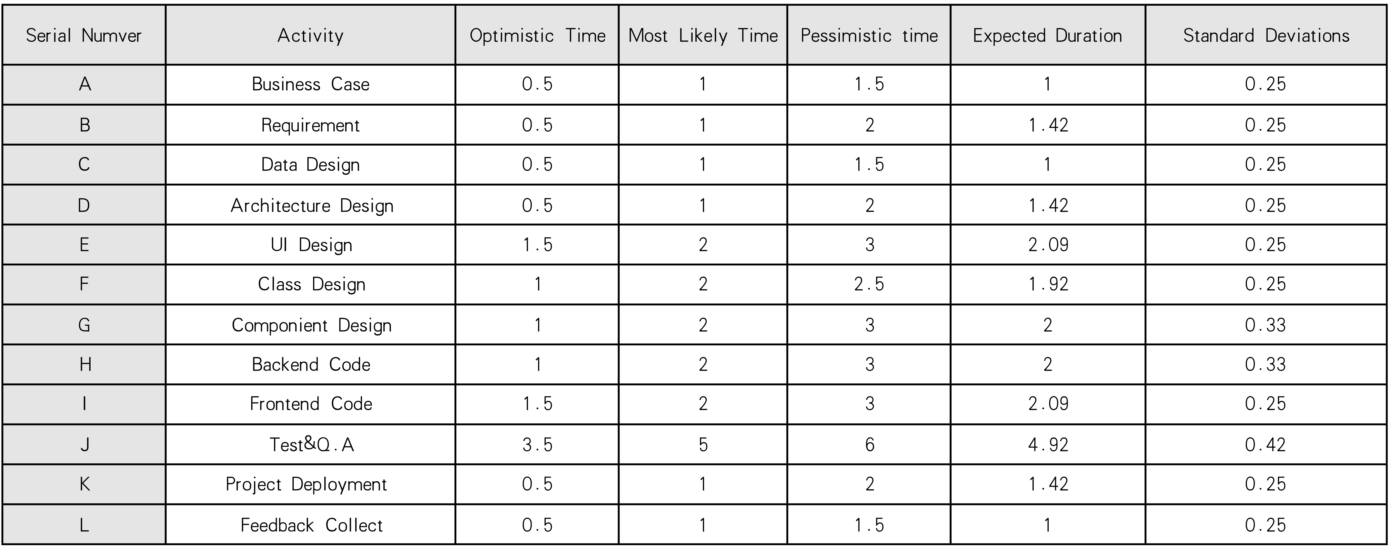
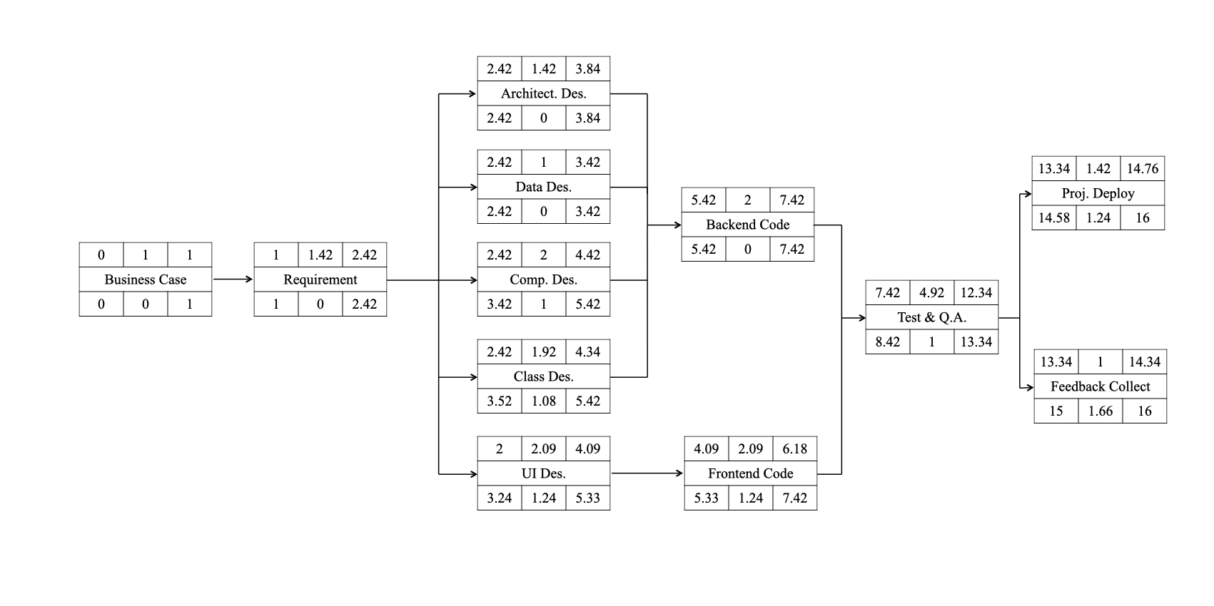
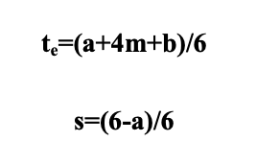
3
Risk Evaluation
PERT Activities Schedule
We use PERT(Program Evaluation and Review Technique) for risk evaluation. PERT was developed to deal with the uncertainly surrounding estimates of task durations.
First we divided the global task into sub-task, and estimating for three times, Most likely time(a), Optimistic time(m) and Pessimistic time(b), then using formula to calculating Expected Duration and Activity Standard Deviations
Project Cycle Activities Network Diagram

Slide 16
4
Part 04
Resource Allocation

Slide 17
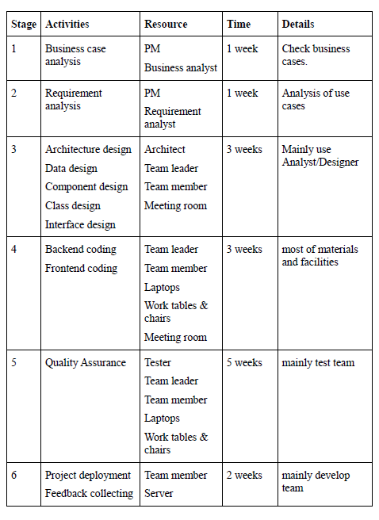
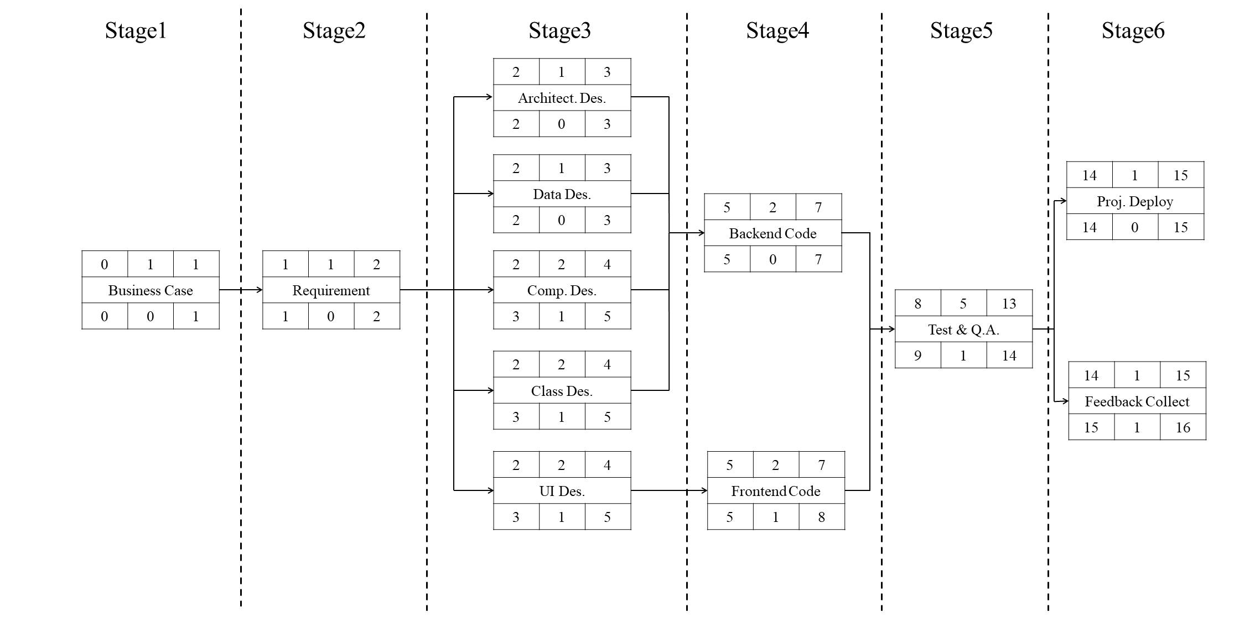
4
Identify Resource Requirement
The resource needed in every stage shows in the following Resource Requirement List.

Slide 18
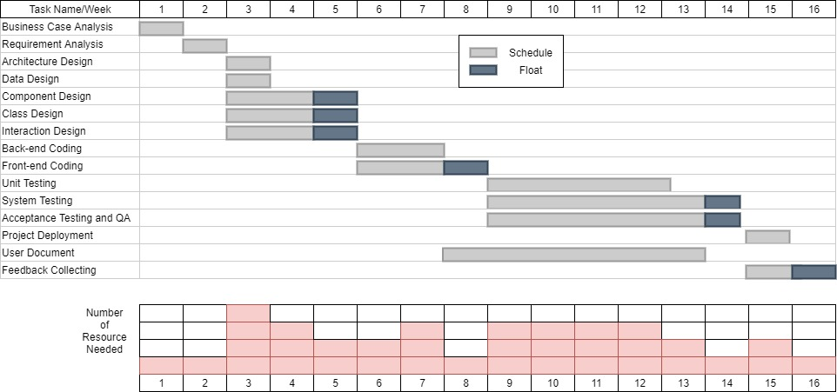
4
Resource Scheduling
The resource histogram exported by Gantt chart.

Slide 19
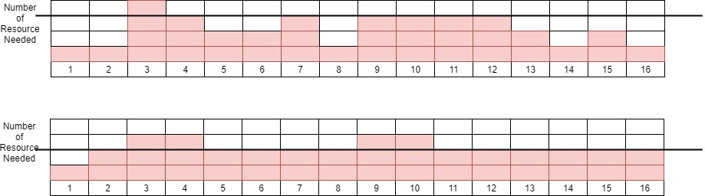
4
Resource Scheduling
We can adjust the start date of some activities and split other, our resource histogram can be smoothed to contain resource demand at available levels. Updated smoothing resource histogram chart is shown below.
We made the resource histogram more smooth so we can assure that we will get wanted resource at necessary time.

Slide 20
5
Part 05
Monitor and Control

Slide 21
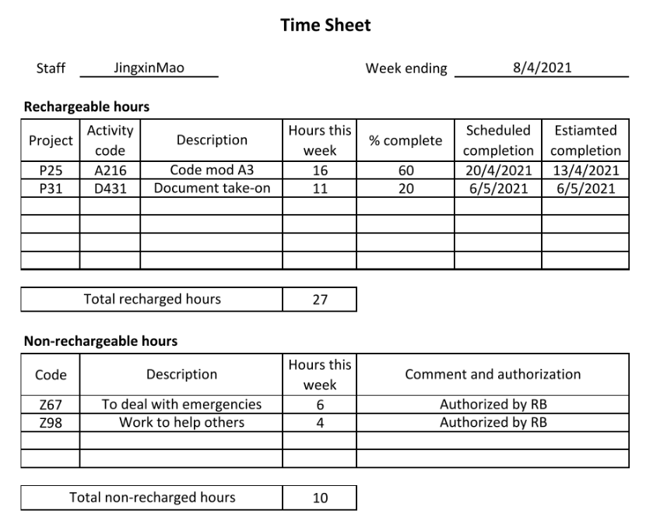
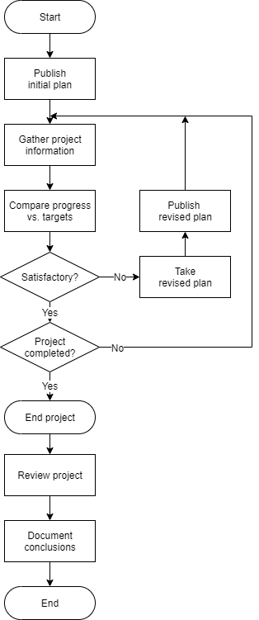
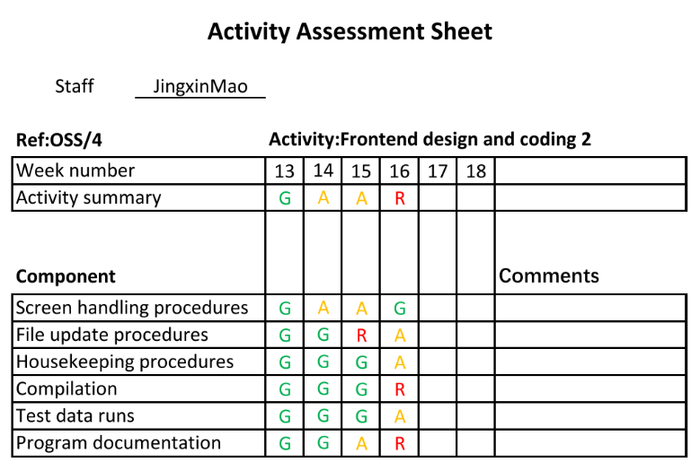
5

Slide 22
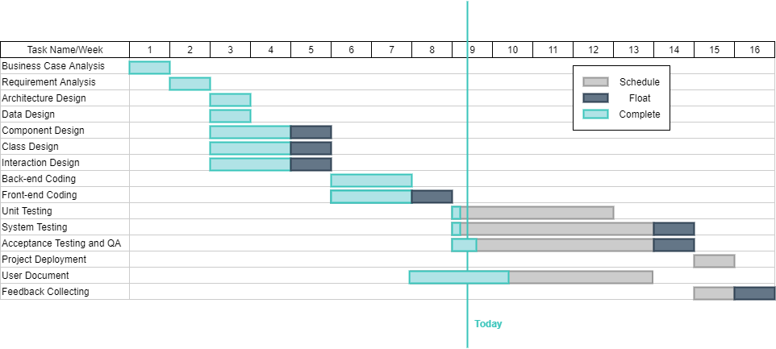
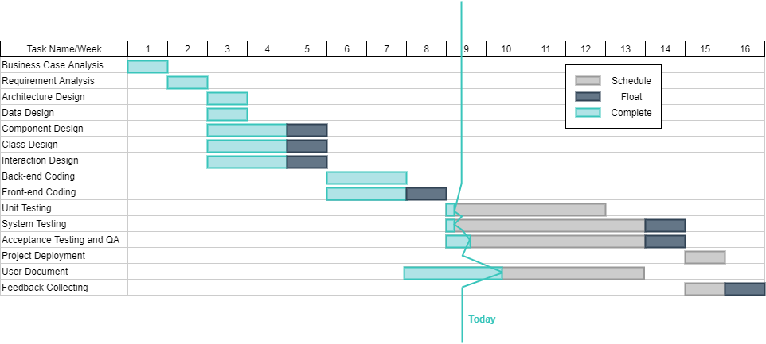
5

Slide 23
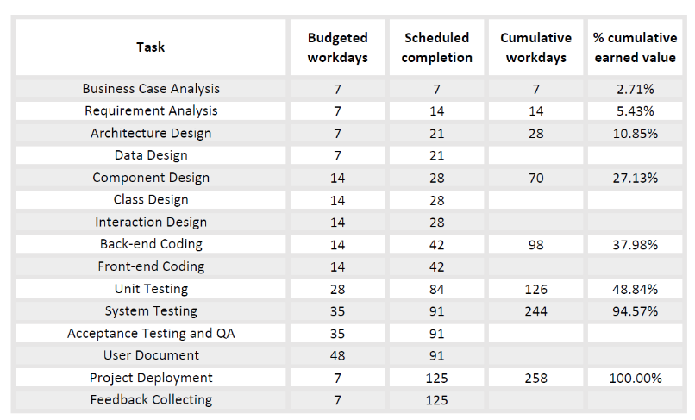
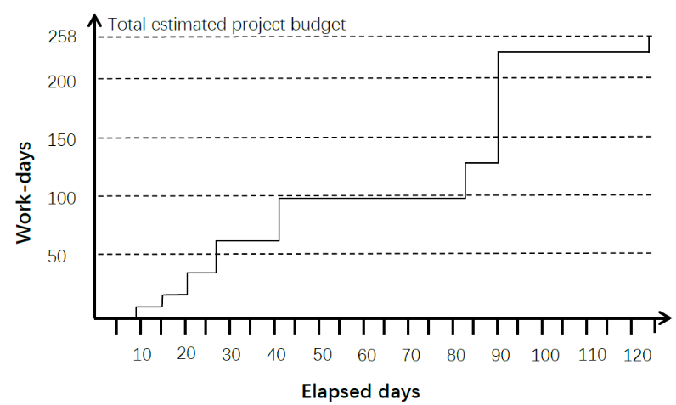
5

Slide 24
6
Part 06
Project Implementation and Prototype

Slide 25
6
Meeting | Time and Task
Planning Meeting | Every Saturday at 14:00. Arrange next week's task Daily Meeting
Retrospective Meeting | Every Saturday at 14:00, review last week's accomplishments before the planning meeting and dynamically adjust the tasks for the next week
Tool | Illustration | Offical Web
Microsoft Visual Studio 2019 | IDE | https://www.microsoftstore.com.cn/software/visual-studio
Visual Studio Code | IDE | https://code.visualstudio.com/
MySQL Workbench 8.0.23 | Database design tool | https://dev.mysql.com/downloads/workbench/
AliYun | Deployment platform | https://cn.aliyun.com/
Environment | Version | Download Url
Asp.net MVC | 3 | https://www.microsoft.com/zh-cn/download/details.aspx?id=4211
Mysql | 5.7.30-winx64 | https://downloads.mysql.com/archives/community/

Slide 26
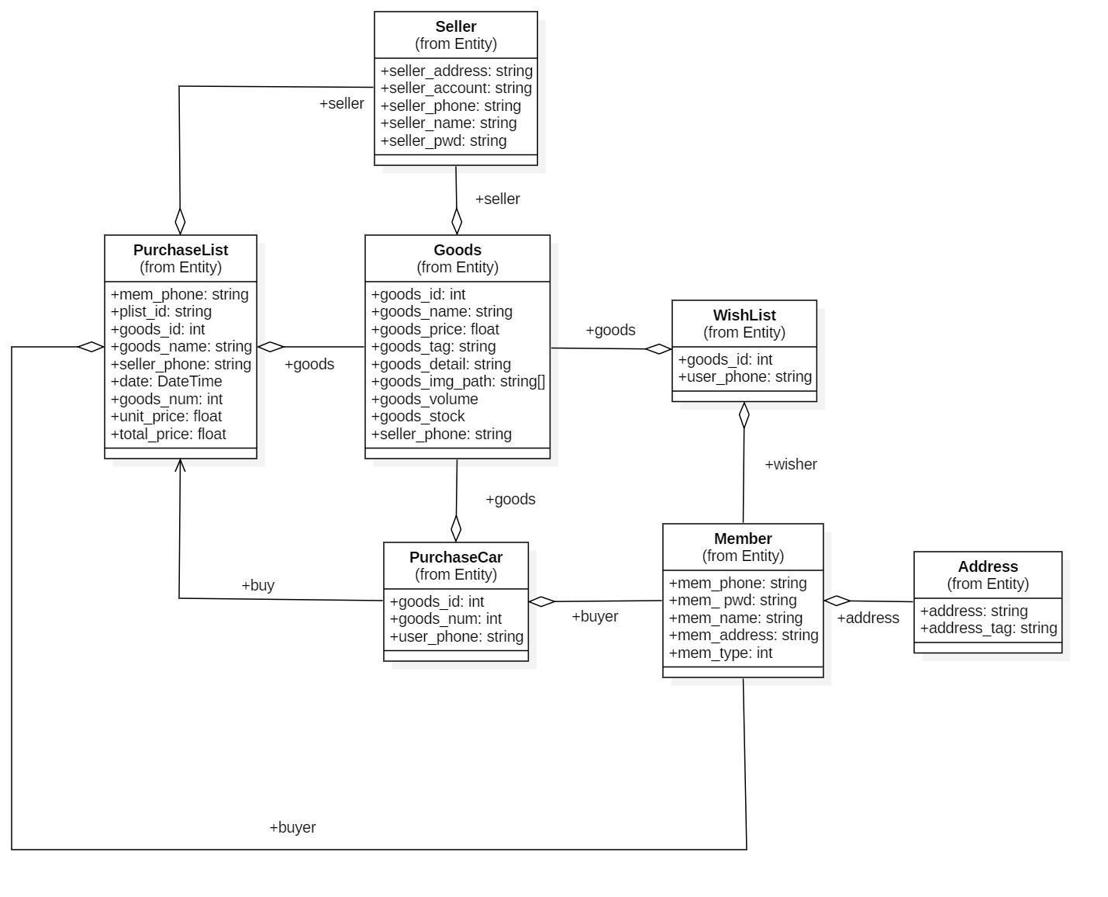
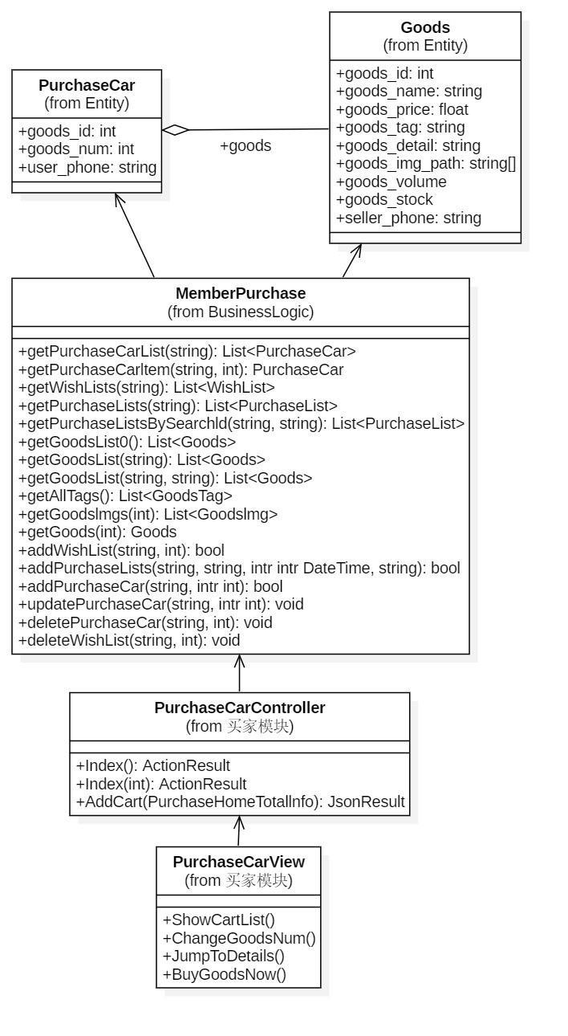
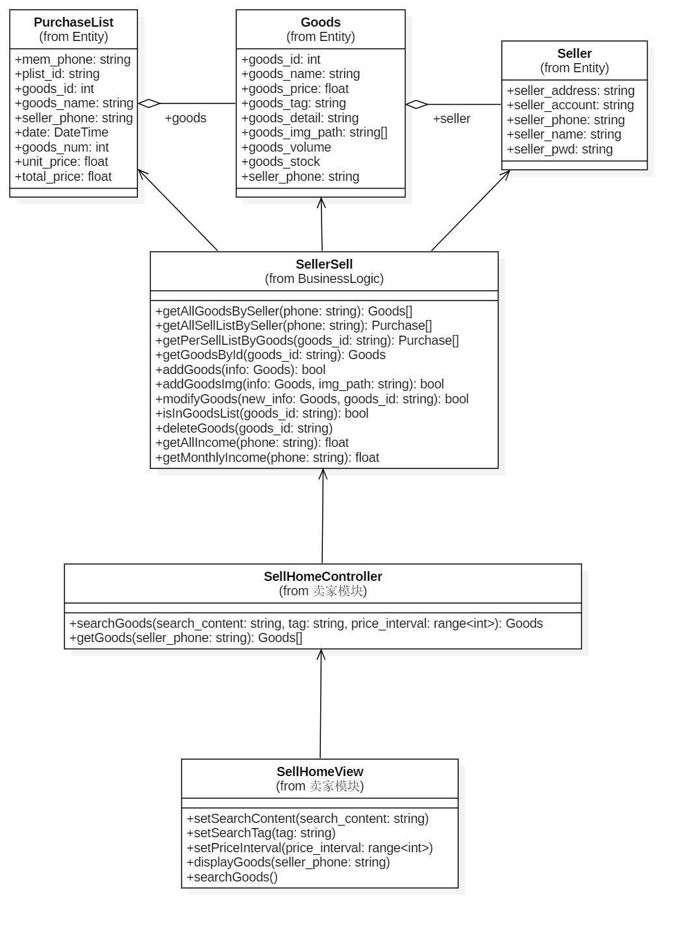
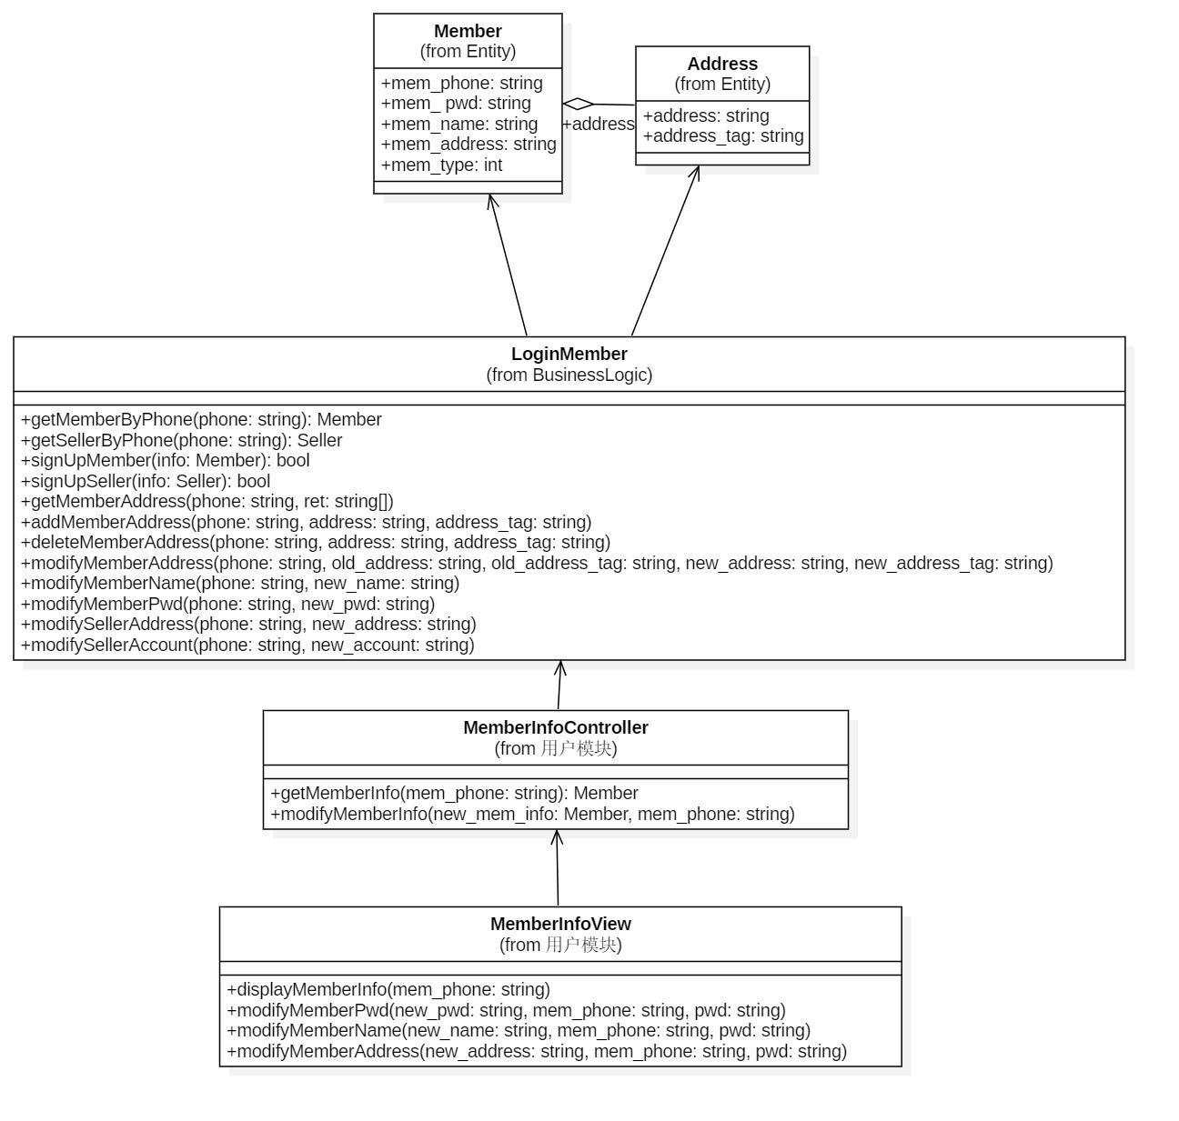
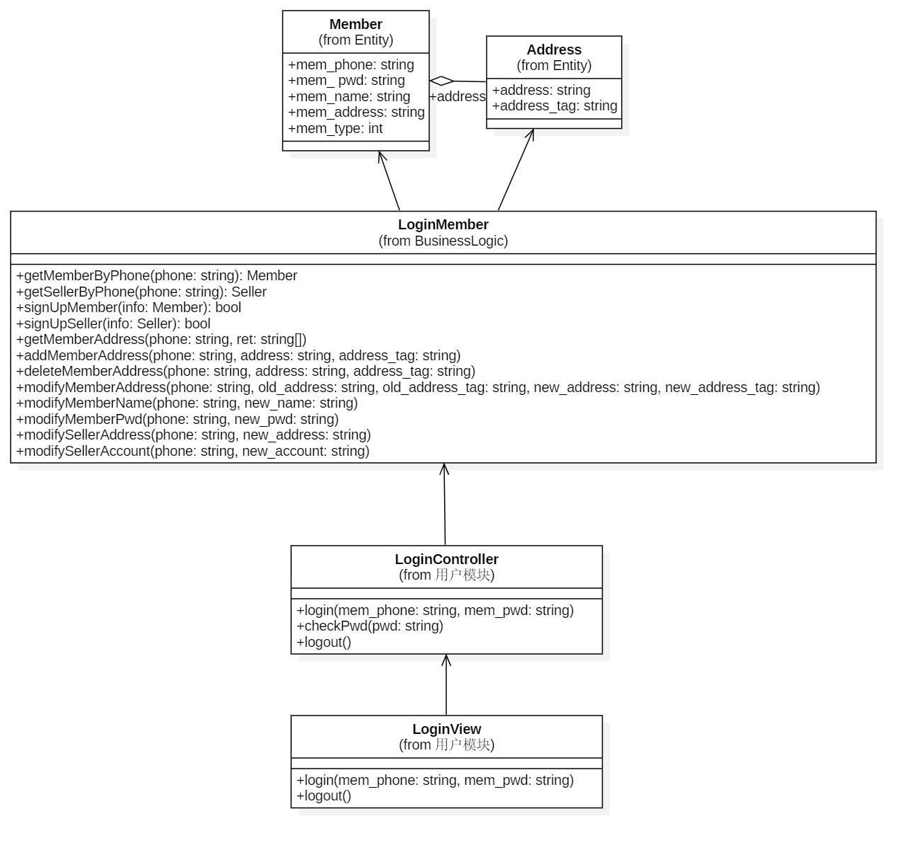
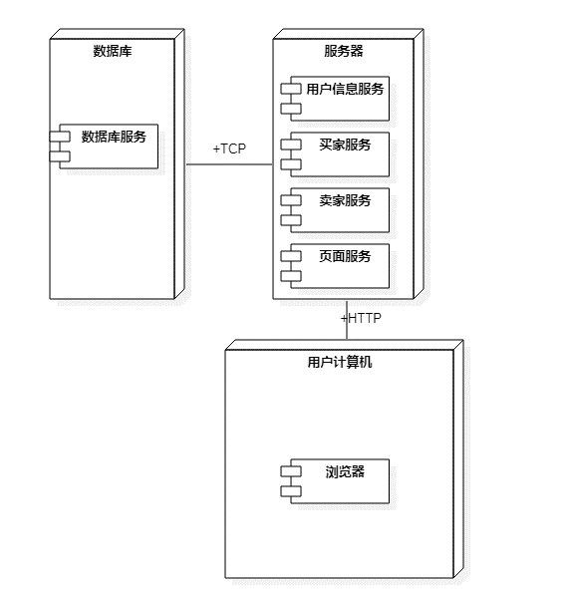
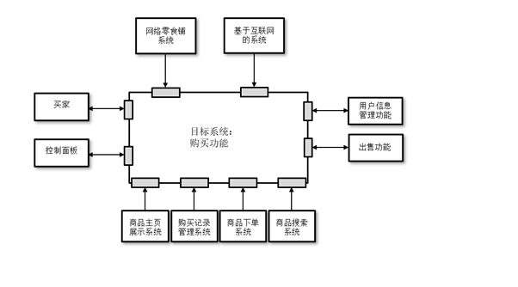
6

Slide 27
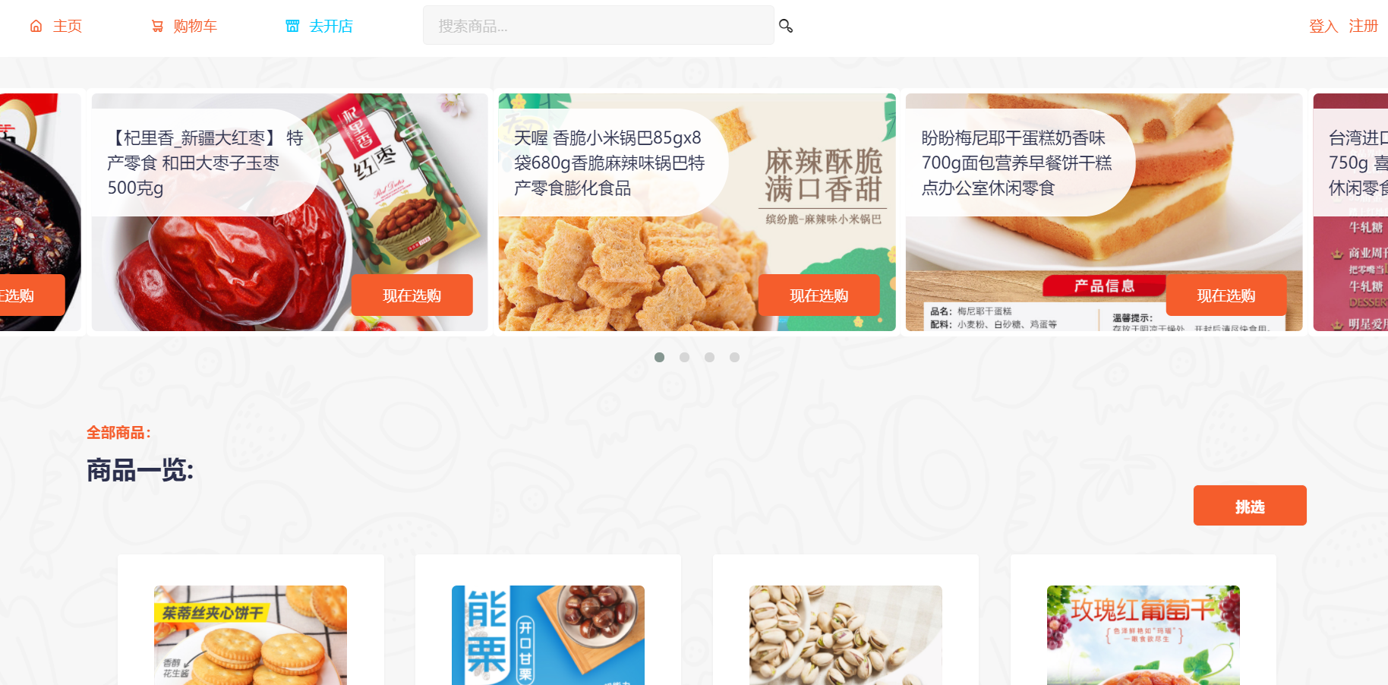
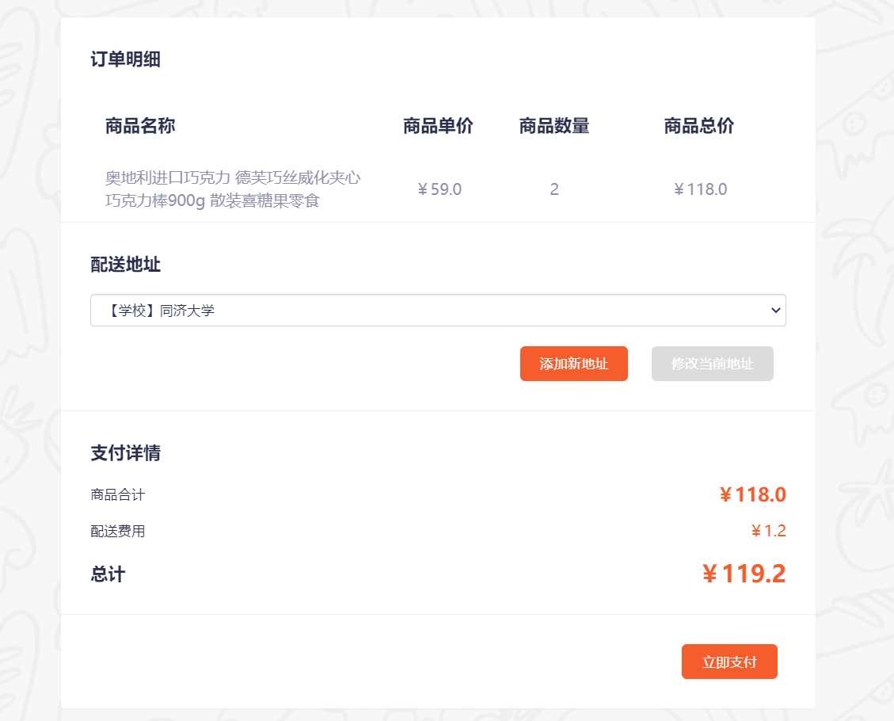
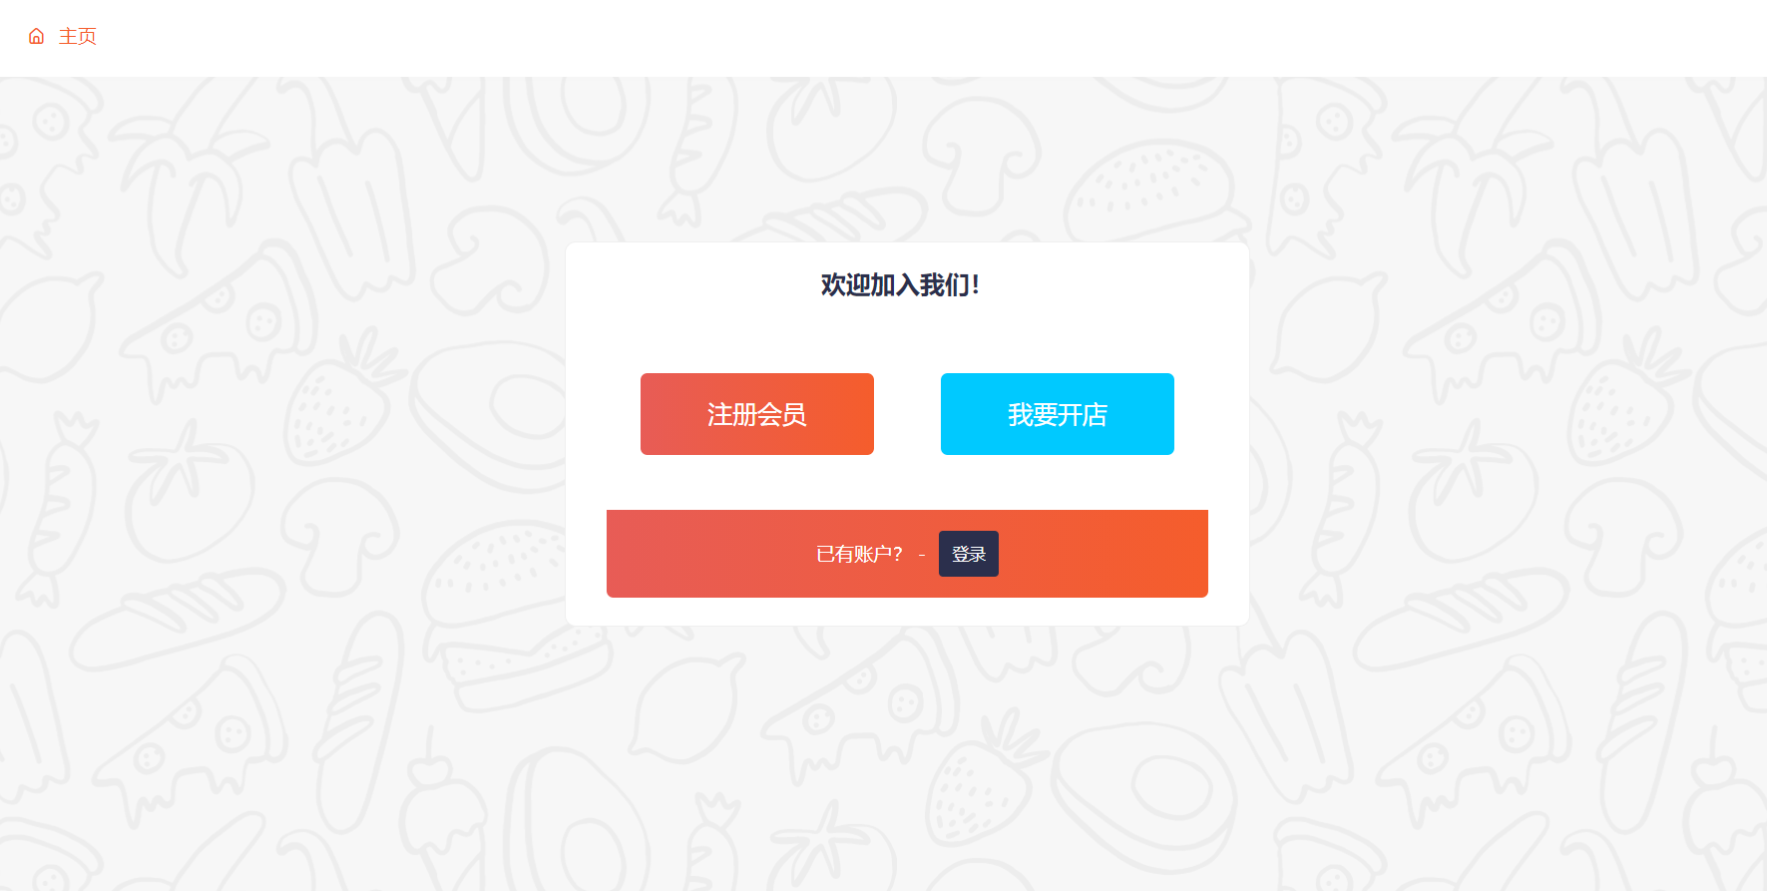
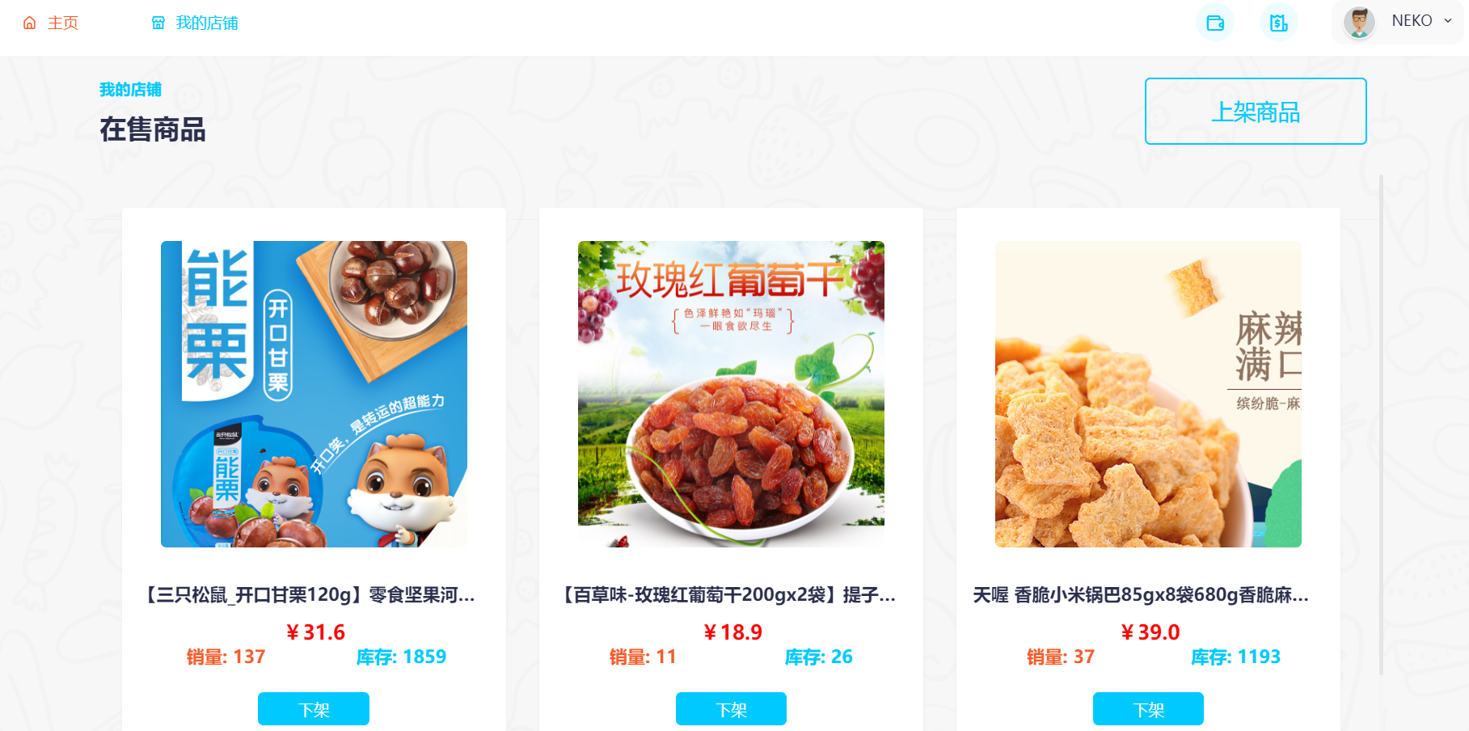
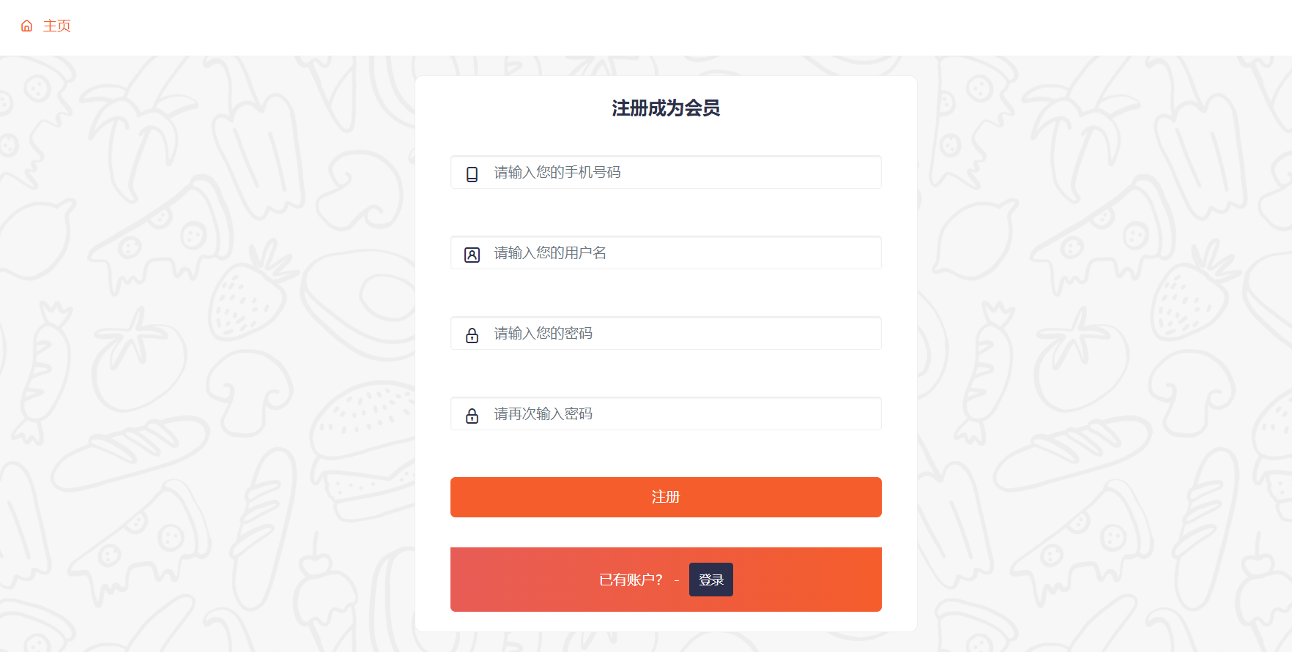
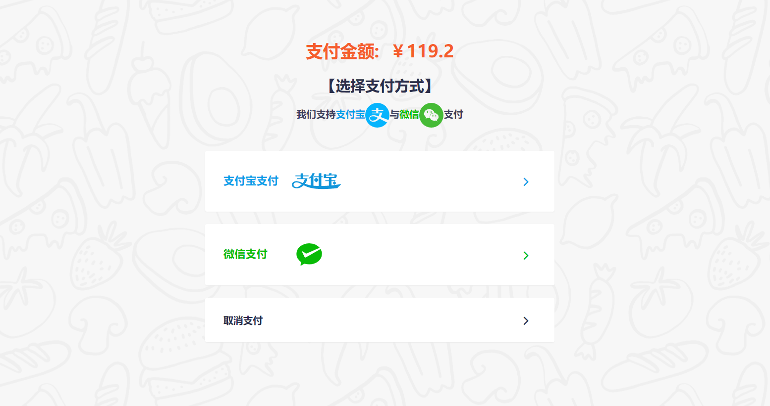
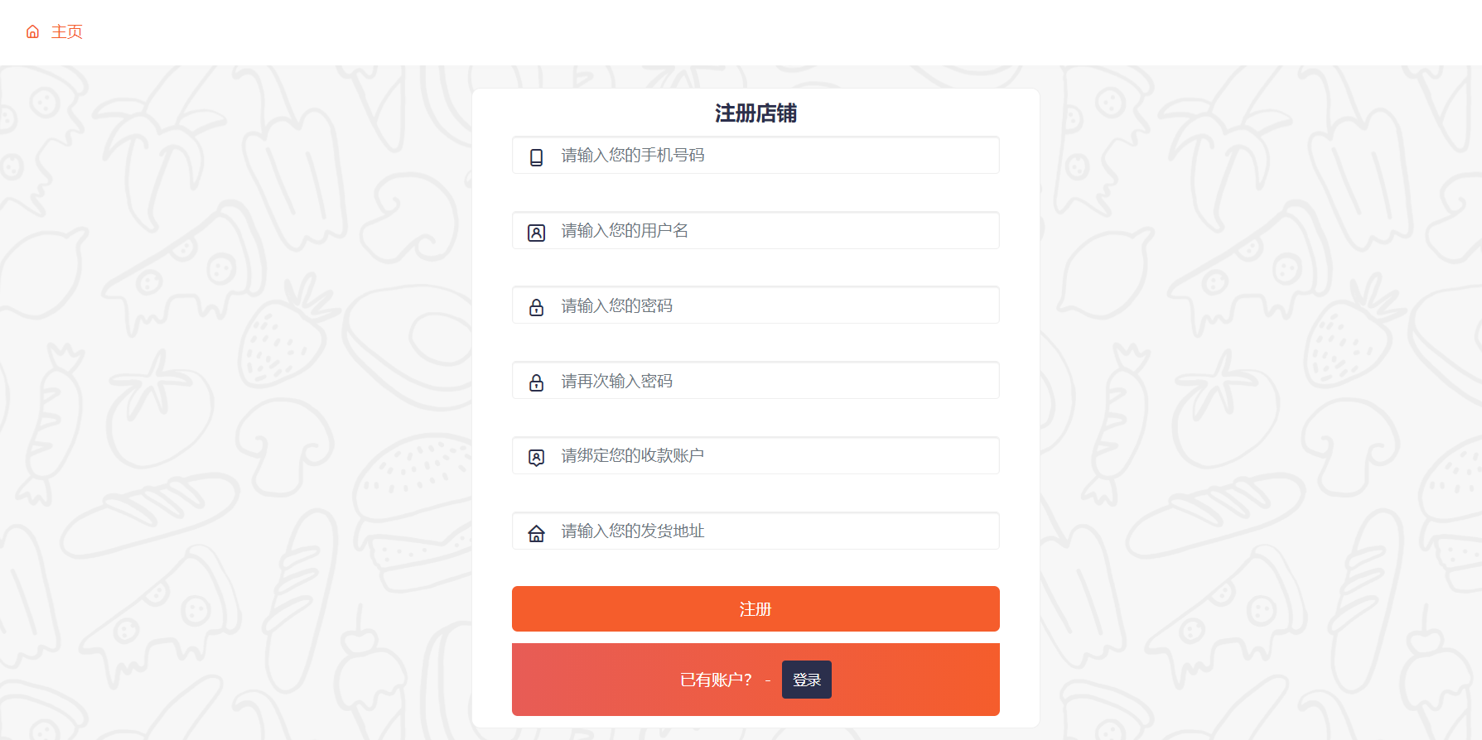
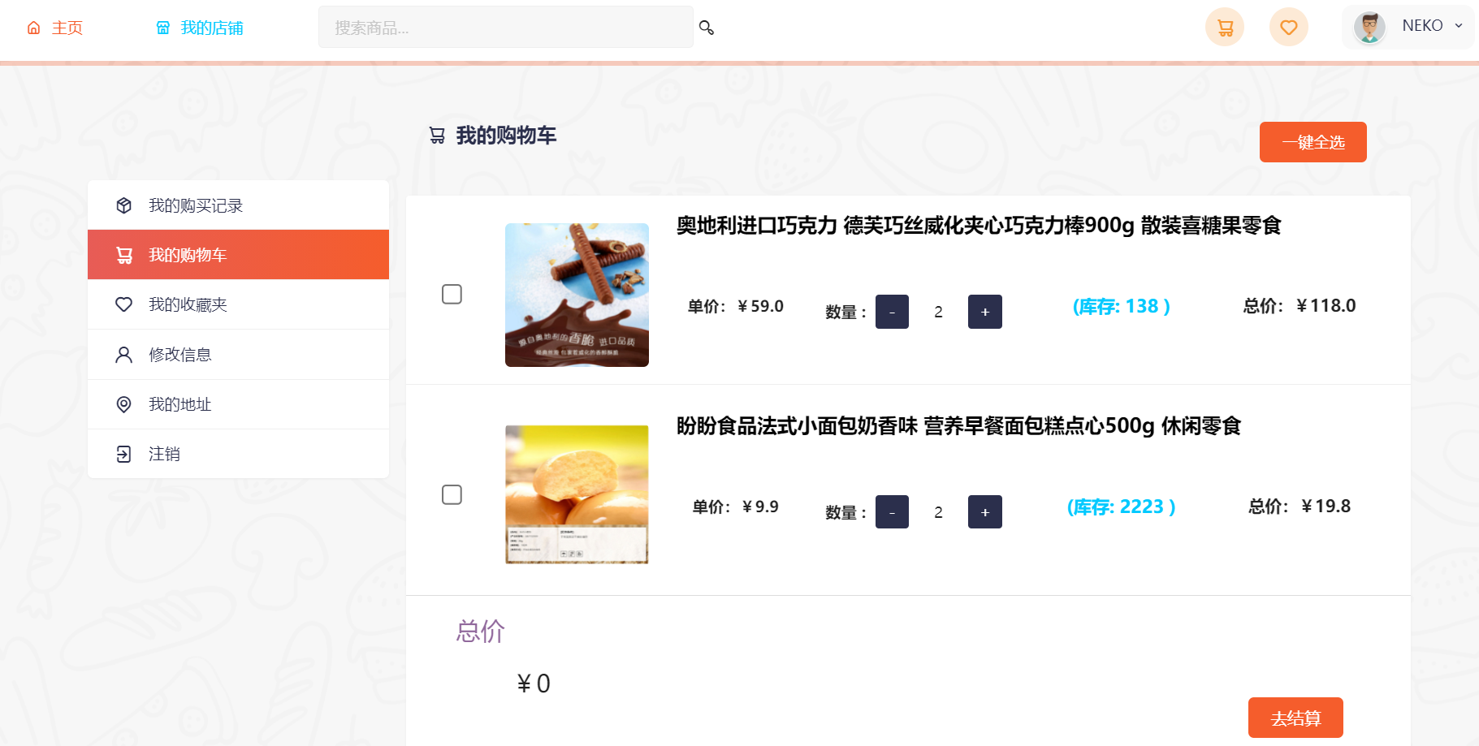
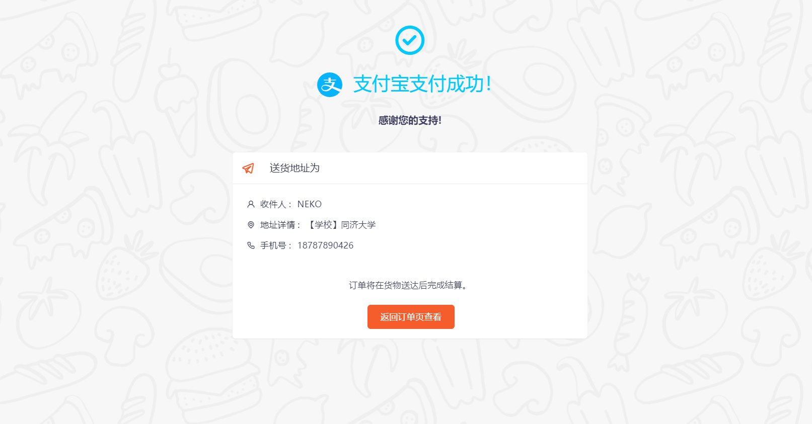
6
Partial Prototype Display

Slide 28
Thank You
.
.
.
References
Kathy, Schwalbe. Information Technology Project Management 6th.
Robert Hughes et al.Software Project Management.5thEdition.2009
Notes:
大侠素材铺 淘宝店：https://dxpu.taobao.com/

